Slide 1


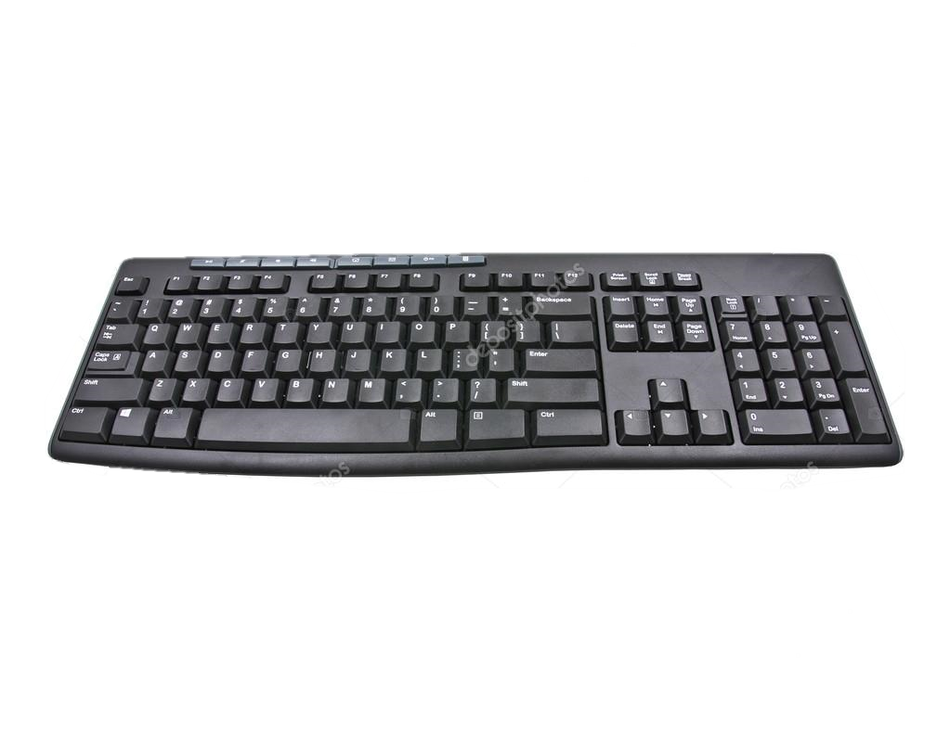

Apex
TM
Systems
KEY
_______________________________________
BO
KEY
BOARD
NEXT
ARD
Copyright © APEX Systems Inc. all rights reserved

Slide 2

Apex
TM
Systems
COMPU
_________________________________________
NEXT
TER
COMPUTER
Copyright © APEX Systems Inc. all rights reserved

Slide 3
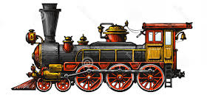
Apex
TM
Systems
LOCOMO
______________________________________
NEXT
TIVE
LOCOMOTIVE
Copyright © APEX Systems Inc. all rights reserved

Slide 4
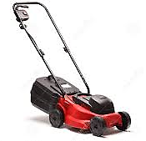
Apex
TM
Systems
LAWN
MO
__________________________________________
NEXT
LAWN
MOWER
WER
Copyright © APEX Systems Inc. all rights reserved

Slide 5
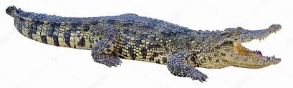
Apex
TM
Systems
CROCO
DILE
____________________________________
NEXT
CROCODILE
Copyright © APEX Systems Inc. all rights reserved

Slide 6
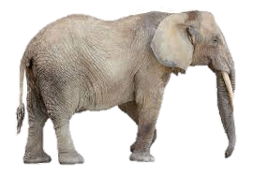
Apex
TM
Systems
ELE
PHANT
__________________________________
NEXT
ELEPHANT
Copyright © APEX Systems Inc. all rights reserved

Slide 7
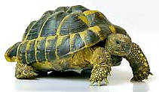
Apex
TM
Systems
TUR
TLE
_________________________________
NEXT
TURTLE
Copyright © APEX Systems Inc. all rights reserved

Slide 8
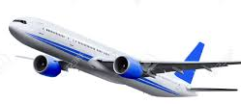
Apex
TM
Systems
AIR
PLA
________________________________________
NEXT
AIR
PLANE
NE
Copyright © APEX Systems Inc. all rights reserved

Slide 9
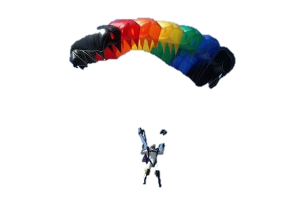

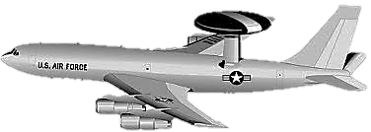
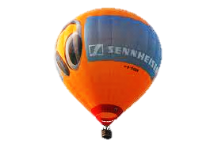
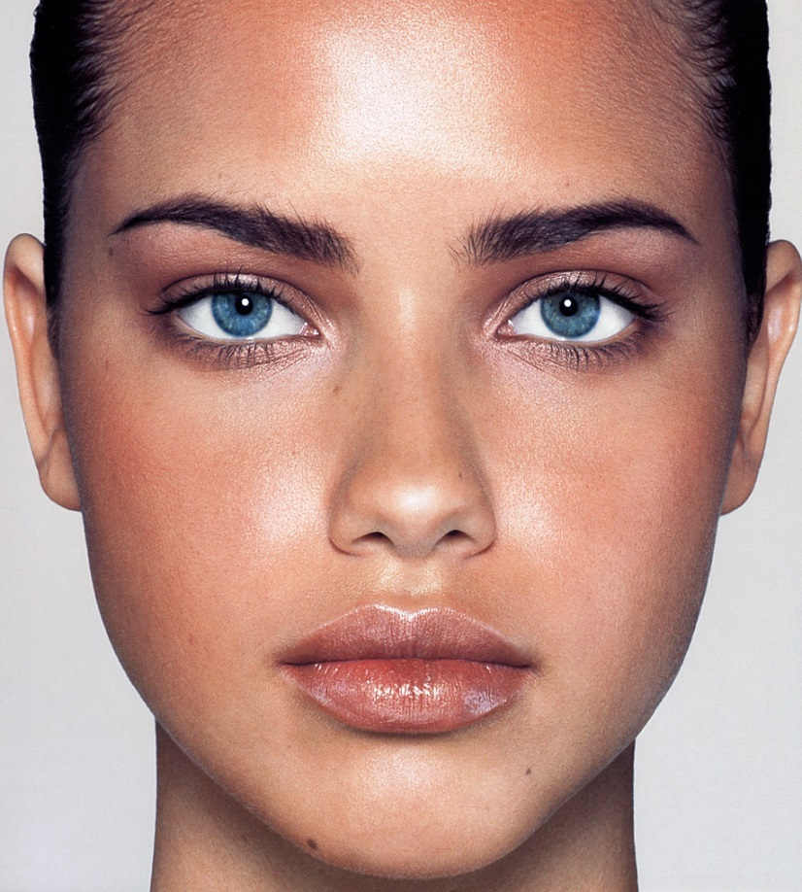

Apex
TM
Systems
DESCRIBE THE ACTION
Copyright © APEX Systems Inc. all rights reserved

Slide 10

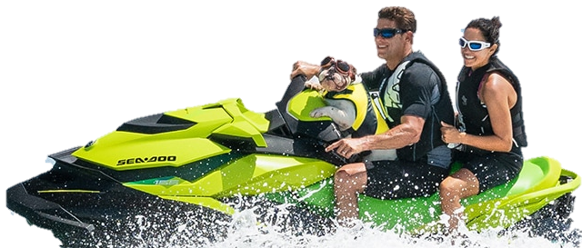
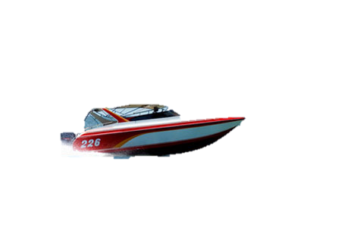
DESCRIBE THE ACTION
Copyright © APEX Systems Inc. all rights reserved

Slide 11






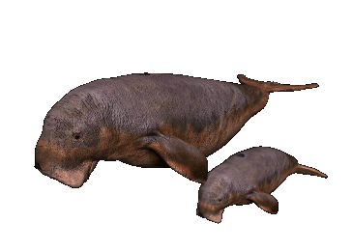
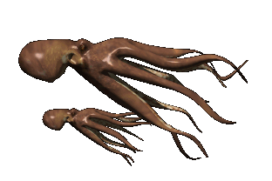
DESCRIBE THE ACTION

